Slide 1
Learning from Examples
Chapter 18

Slide 2
Outline
Forms of Learning
Supervised learning
Learning Decision Trees

Slide 3
Learning agents
Any component of an agent can be improved by learning from data.
The improvements, and the techniques used to make them, depend on four major factors:
  Which component is to be improved
  What prior knowledge the agent already has
  What representation is used for the data and the component
  What feedback is available to learn from

Slide 4
Components to be learned
The components of these agents include:
  A direct mapping from conditions on the current state to actions.
  A means to infer relevant properties of the world from the percept sequence.
  Information about the way the world evolves and about the results of possible actions the agent can take.
  Utility information indicating the desirability of world states.
  Action-value information indicating the desirability of actions.
  Goals that describe classes of states whose achievement maximizes the agent’s utility.

Slide 5
Inductive learning
Informally, learning a general function or rule from specific input–output pairs
  f is the target function, an example is a pair (x, f(x))
  Find a hypothesis h, such that h ≈ f given a training set of examples
Type of feedback:
  Supervised learning: correct answers for each example
  Unsupervised learning: correct answers not given
  Reinforcement learning: occasional rewards

Slide 6
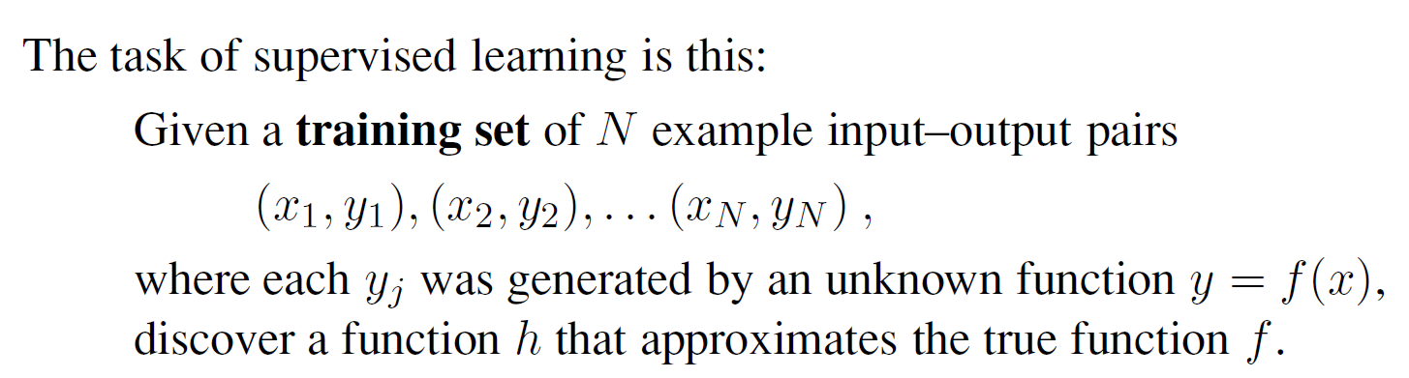
Supervised learning
Here x and y can be any value; they need not be numbers. h is a hypothesis, find a hypothesis h, such that h ≈ f given a training set of examples

Slide 7
Supervised learning
To measure the accuracy of a hypothesis we give it a test set of examples that are distinct from the training set. We say a hypothesis generalizes well if it correctly predicts the value of y for novel examples. Sometimes the function f is stochastic—it is not strictly a function of x, and what we have to learn is a conditional probability distribution, P(Y | x).

Slide 8
Supervised learning
Regression: number, numeric value
To measure the accuracy of a hypothesis we give it a test set of examples that are distinct from the training set. We say a hypothesis generalizes well if it correctly predicts the value of y for novel examples. Sometimes the function f is stochastic—it is not strictly a function of x, and what we have to learn is a conditional probability distribution, P(Y | x).
Classification: one of a finite set of values

Slide 9
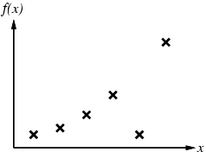
Supervised learning method
Construct/adjust h to agree with f on training set
(h is consistent if it agrees with f on all examples)
E.g., curve fitting:

Slide 10
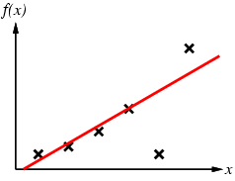
Supervised learning method
Construct/adjust h to agree with f on training set
(h is consistent if it agrees with f on all examples)
E.g., curve fitting:

Slide 11
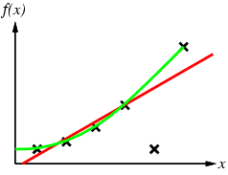
Supervised learning method
Construct/adjust h to agree with f on training set
(h is consistent if it agrees with f on all examples)
E.g., curve fitting:

Slide 12
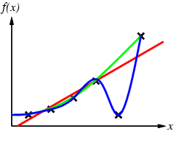
Supervised learning method
Construct/adjust h to agree with f on training set
(h is consistent if it agrees with f on all examples)
E.g., curve fitting:

Slide 13
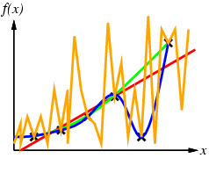
Supervised learning method
Construct/adjust h to agree with f on training set
(h is consistent if it agrees with f on all examples)
E.g., curve fitting:

Slide 14
Supervised learning method
Construct/adjust h to agree with f on training set
(h is consistent if it agrees with f on all examples)
E.g., curve fitting:
Ockham’s razor: prefer the simplest hypothesis consistent with data

Slide 15
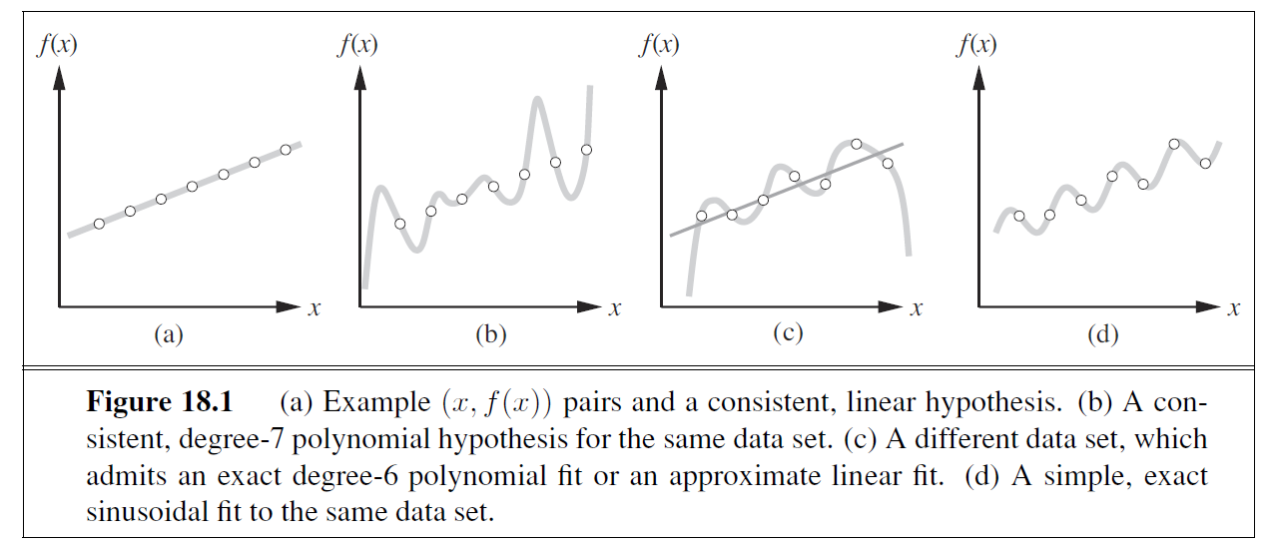
Supervised learning method
A straight line that is not consistent with any of the data points, but might generalize fairly well for unseen values of x, is also shown in (c).
In general, there is a tradeoff between complex hypotheses that fit the training data well and simpler hypotheses that may generalize better.

Slide 16
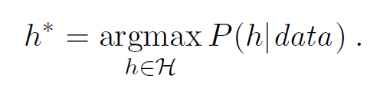
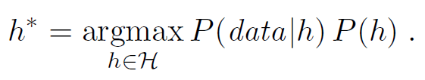
Supervised learning method
Supervised learning can be done by choosing the hypothesis h* that is most probable given the data:
By Bayes’ rule
Then we can say that the prior probability P(h) is high for a degree-1 or -2 polynomial, lower for a degree-7 polynomial. We allow unusual-looking functions when the data say we really need them, but we discourage them by giving them a low prior probability.

Slide 17
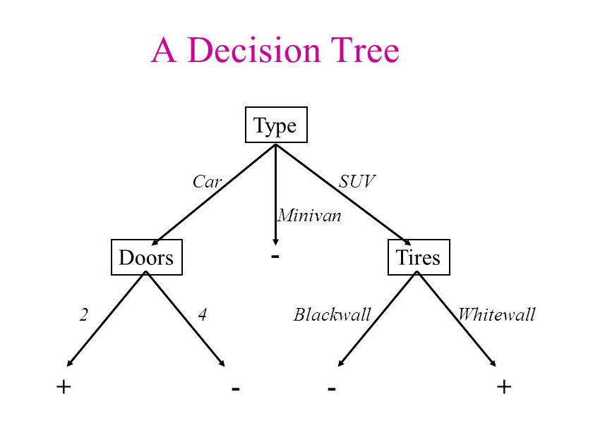
Learning decision trees
Decision tree is one of the simplest and yet most successful forms of machine learning.
A decision tree represents a function that takes as input a vector of attribute values and returns a “decision”—a single output value. The input and output values can be discrete or continuous.

Slide 18
Learning decision trees
Decision tree is one of the simplest and yet most successful forms of machine learning.
A decision tree reaches its decision by performing a sequence of tests.
Each internal node in the tree corresponds to a test of the value of one of the input attributes, A_{i}, and the branches from the node are labeled with the possible values of the attribute, A_{i} =v_{ik}.
Each leaf node in the tree specifies a value to be returned by the function.
internal
node
leaf nodes

Slide 19
Learning decision trees
Problem: decide whether to wait for a table at a restaurant (WillWait), based on the following attributes:
  Alternate: is there an alternative restaurant nearby?
  Bar: is there a comfortable bar area to wait in?
  Fri/Sat: is today Friday or Saturday?
  Hungry: are we hungry?
  Patrons: number of people in the restaurant (None, Some, Full)
  Price: price range ($, $$, $$$)
  Raining: is it raining outside?
  Reservation: have we made a reservation?
  Type: kind of restaurant (French, Italian, Thai, Burger)
  WaitEstimate: estimated waiting time (0-10, 10-30, 30-60, >60)

Slide 20
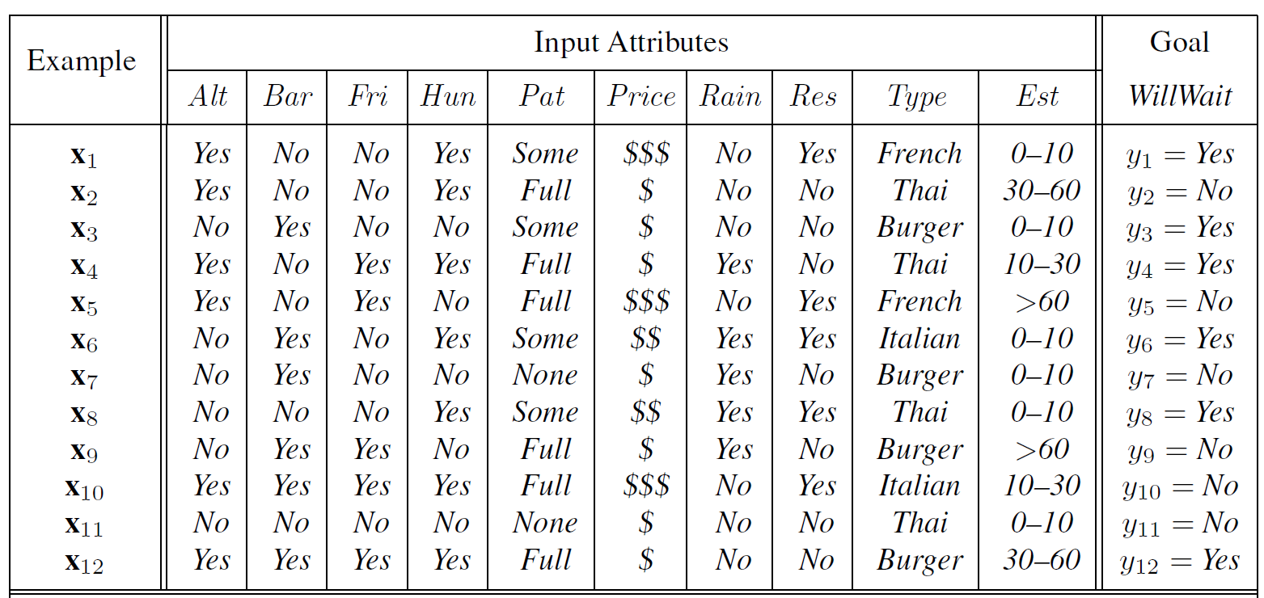
Attribute-based representations
Examples described by attribute values (Boolean, discrete, continuous)
E.g., situations where I will/won't wait for a table:
Classification of examples is positive (T) or negative (F)

Slide 21
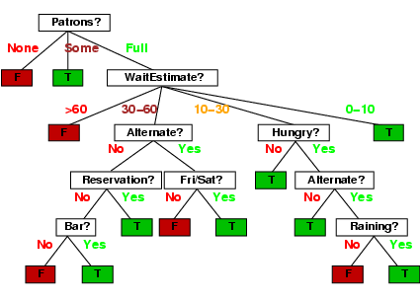
Decision trees
One possible representation for hypotheses
E.g., here is the “true” tree for deciding whether to wait:

Slide 22
Decision trees
One possible representation for hypotheses
E.g., here is the “true” tree for deciding whether to wait:

Slide 23
Decision trees
One possible representation for hypotheses
E.g., here is the “true” tree for deciding whether to wait:

Slide 24
Decision trees
One possible representation for hypotheses
E.g., here is the “true” tree for deciding whether to wait:

Slide 25
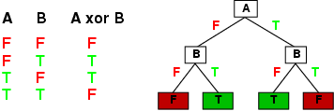
Expressiveness
Decision trees can express any function of the input attributes.
E.g., for Boolean functions, truth table row → path to leaf:
Trivially, there is a consistent decision tree for any training set with one path to leaf for each example (unless f nondeterministic in x) but it probably won't generalize to new examples
Prefer to find more compact decision trees
Notes:
This is just the number of different truth tables that we can write down, because the function is defined by its truth table. A truth table over n attributes has 2n rows, one for each combination of
values of the attributes. We can consider the “answer” column of the table as a 2n-bit number that defines the function. That means there are 22n different functions (and there will be more than that number of trees, since more than one tree can compute the same function).

Slide 26
Hypothesis spaces
How many distinct decision trees with n Boolean attributes?
= number of Boolean functions 2^{n}
= number of distinct truth tables with 2^{n} rows = 2^{2n}
E.g., with 6 Boolean attributes, there are 18,446,744,073,709,551,616 trees

Slide 27
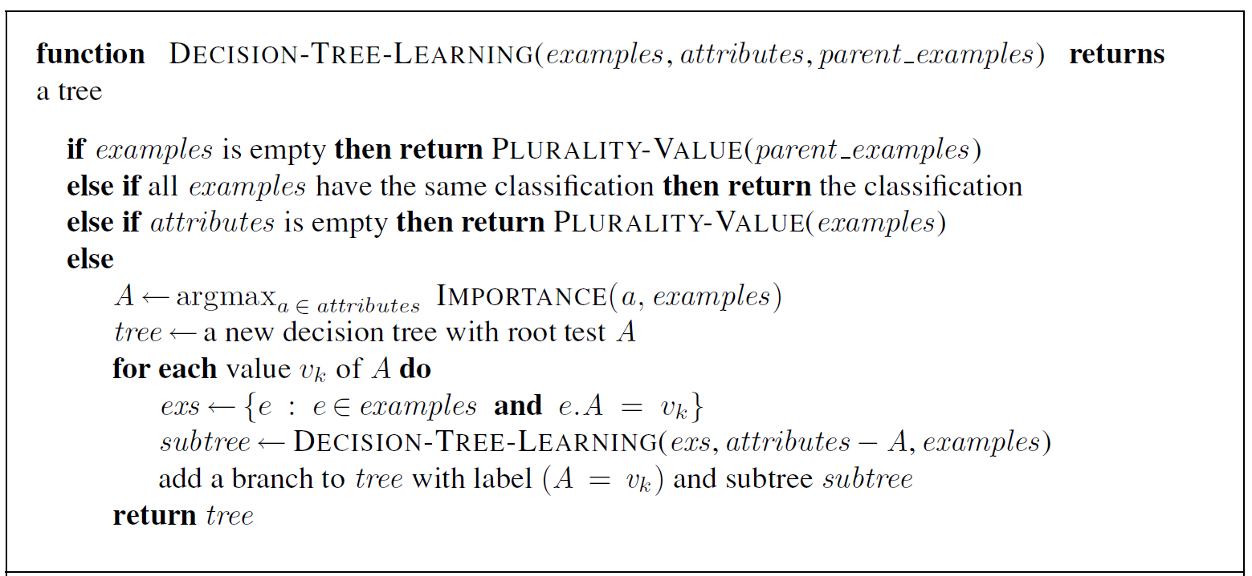
Decision tree learning
Aim: find a small tree consistent with the training examples
Idea: greedy divide-and-conquer strategy — always test the most important attribute first. (recursively) choose "most significant" attribute as root of (sub)tree

Slide 28
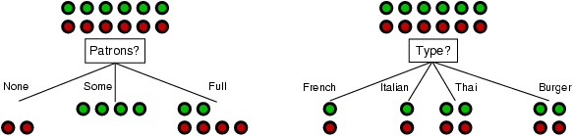
Choosing an attribute
Idea: a good attribute splits the examples into subsets that are (ideally) "all positive" or "all negative"
Patrons? is a better choice

Slide 29
Choosing attribute tests

Slide 30
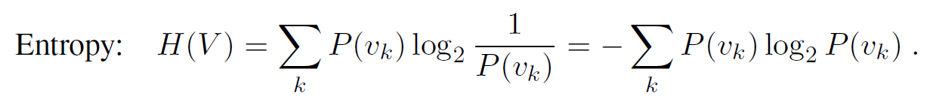
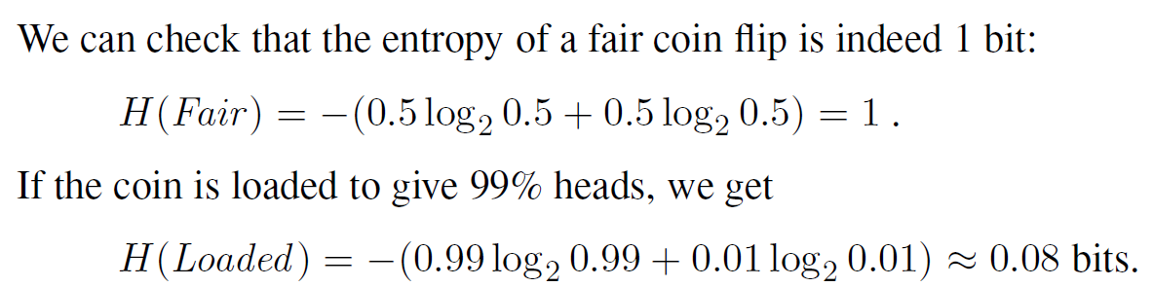
Using Information gain
Information gain, which is defined in terms ENTROPY of entropy, the fundamental quantity in information theory
In general, the entropy of a random variable V with values v_{k}, each with probability P(v_{k}), is defined as
E.g.

Slide 31
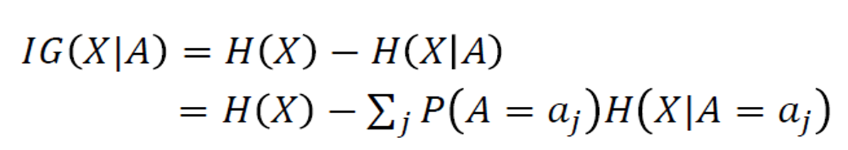
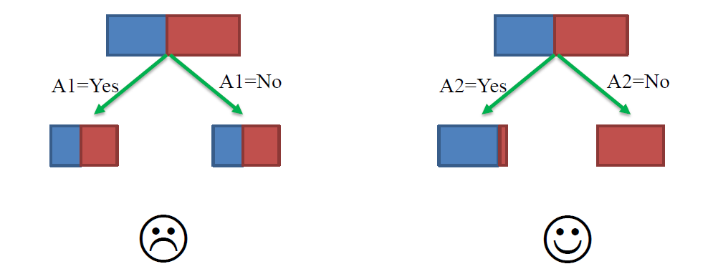
Using Information gain
Information gain, which is defined in terms ENTROPY of entropy, the fundamental quantity in information theory

Slide 32
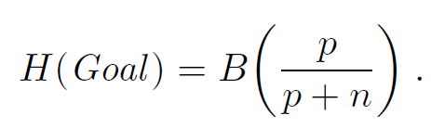
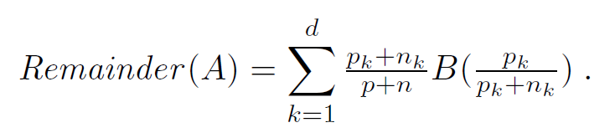

Using Information gain
Rewrite Entropy as
An attribute A with d distinct values divides the training set E into subsets E₁, . . . ,E_{d}. Each subset E_{k} has p_{k} positive examples and n_{k} negative examples,
The information gain from the attribute test on A is the expected reduction in entropy

Slide 33
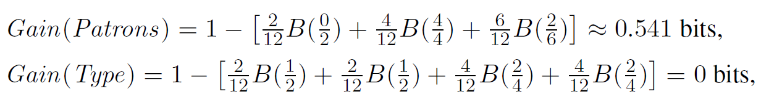
Information gain
For the training set, p = n = 6, I(6/12, 6/12) = 1 bit
Consider the attributes Patrons and Type:
Patrons has the highest Information Gain of all attributes and so is chosen by the DTL algorithm as the root

Slide 34
Information gain
For the training set, p = n = 6, I(6/12, 6/12) = 1 bit
Consider the attributes Patrons and Type:

Slide 35
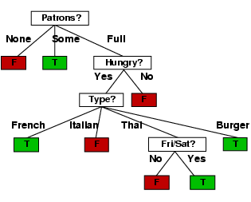
Example contd.
Decision tree learned from the 12 examples:

Slide 36
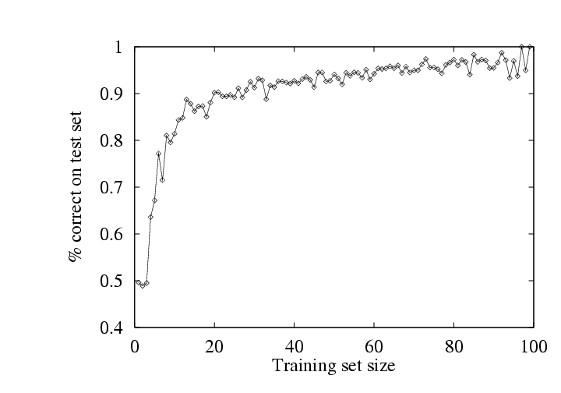
Performance measurement
How do we know that h ≈ f ?
  Use theorems of computational/statistical learning theory
  Try h on a new test set of examples
    (use same distribution over example space as training set)
Learning curve = % correct on test set as a function of training set size

Slide 37
Overfitting and Pruning
Overfitting—A general phenomenon, overfitting occurs with all types of learners, even when the target function is not at all random.

Slide 38
Overfitting and Pruning
Overfitting—A general phenomenon, overfitting occurs with all types of learners, even when the target function is not at all random.
For decision trees, a technique called decision tree pruning combats overfitting. Pruning works by eliminating nodes that are not clearly relevant.

Slide 39
Overfitting and Pruning
Overfitting—A general phenomenon, overfitting occurs with all types of learners, even when the target function is not at all random.
For decision trees, a technique called decision tree pruning combats overfitting. Pruning works by eliminating nodes that are not clearly relevant.
How to define relevant or irrelevant?

Slide 40
Overfitting and Pruning
Suppose we are at a node consisting of p positive and n negative examples. If the attribute is irrelevant, we would expect that it would split the examples into subsets that each have roughly the same proportion of positive examples as the whole set, p/(p +n), and so the information gain will be close to zero.

Slide 41
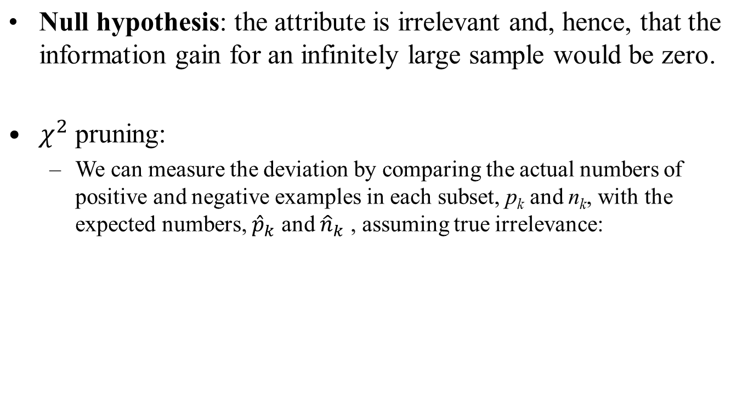
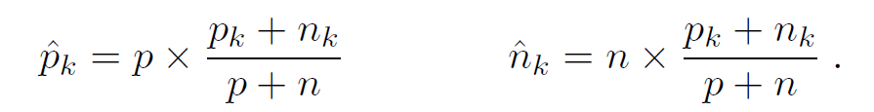
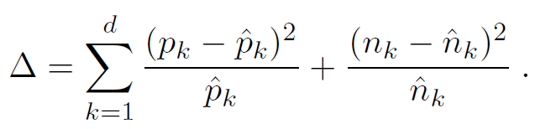
Overfitting and Pruning

Slide 42
随机森林算法
Random Forest Classifier

Slide 43
引言
单模型分类方法模往精度不高，容易出现过拟合问题，因此往往通过组合多个单分类器模型提高精度，这些方法称为集成学习方法。
随机森林是为了解决单个决策树模型过拟合问题而提出一种集成学习算法。
随机森林
  随机森林利用bootstrap重抽样方法从原始抽样中抽取多个样本，然后对每个bootstrap样本进行决策树建模，然后组成多棵决策树进行预测，并通过投票得出最终的预测结果。

Slide 44
Bootstrap重抽样
Bootstrap重抽样技术
  其核心思想是在n个原始样本数据的范围内做有放回的抽样，样本容量仍为n，每个观测对象被抽到的概率相等，即为1/n，它将是样本看做整体，将从样本中抽样得到的子样本看做样本，把所得到这个样本成为bootstrap样本。
使用了bootstrap重采样思想的分类算法，叫做bagging

Slide 45
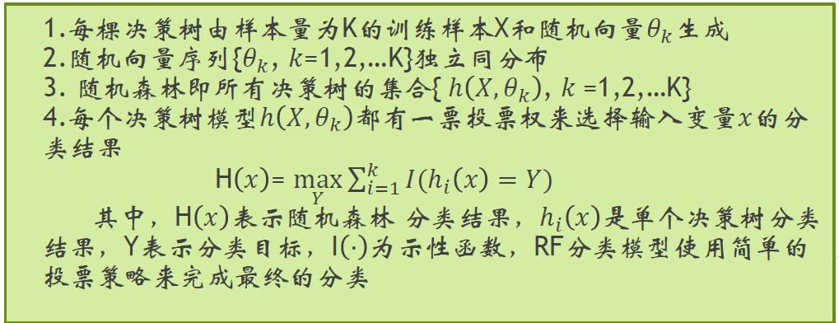
随机森林原理
随机森林
  随机森林利用bootstrap重抽样方法从原始抽样中抽取多个样本，然后对每个bootstrap样本进行决策树建模，然后组成多棵决策树进行预测，并通过投票得出最终的预测结果。

Slide 46
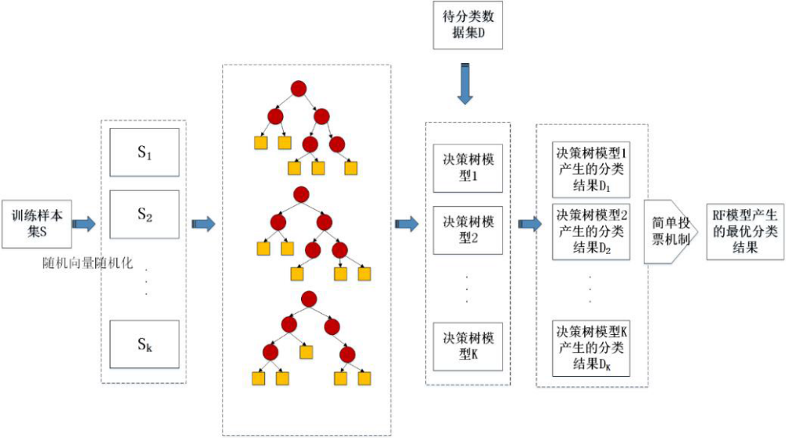
随机森林原理
随机森林算法执行示意图

Slide 47
随机森林原理
随机森林优于决策树？
  假设1：数据样本D中元素只有两类{0,1}
  假设2：随机森林中每棵决策树的正确率 p=0.8
  假设3：随机森林中每棵决策树之间相关系数 0< ρ <1
  假设4：包含 k棵决策树的随机森林正确率，位于 k棵完全相关决策树 和k棵完全非相关决策树之间
  对于 k棵完全相关决策树， 由于某棵树分类正确等价于其他树分类正确，其正确率p1=p=0.8
  对于k棵完全非相关决策树，每棵决策树分类正确与否完全独立，服从二项分布
  K=1时，p(T)=p=0.8, p(F)=1-0.8=0.2
  K=3时，p(T)=p³+3*p*p*(1-p)=0.896, p(F)=1-p(T)=0.104
  K=5时，p(T)=p⁵+5*p⁴*(1-p)+10*p³*(1-p)²=0.94208, p(F)=0.05792

Slide 48
随机森林特性
优点：
  大多数情况可以产生高准确率分类器
  可以处理大量的输入数据
  可以在判断类别是评语数据的重要程度
  对于不平衡的训练数据，有可能可以平衡误差
  学习过程快速
缺点：
  随机森林在噪声较大时表现不好，仍会出现过拟合
  如果属性的划分级别过多，随机森林所产生的属性权值不可信

Slide 49
Thursday
Neural Networks
  Perceptron
  Multi-layer Perceptron
  AutoEncoder
  Convolutional Neural Network
  Recurrent Neural Network
  Graph Neural Network
  …

